Slide 1
Franchising
Chapter 5

Slide 2
Franchising
An agreement between two parties in which one party passes on the rights to other party.
Rights include:
Right to use the trade mark
Right to use the name
Right to use systems, methods and researches
Right to use the packing materials
Sometimes provide training also

Slide 3
Parties of Franchise Agreement
There are two parties:
Franchiser
Franchisee
Franchiser is one who sells the rights to franchisee.
McDonald’s is one of the more expensive franchises—total start-up costs can run more than $1 million.

Slide 4
Advantages of Franchising
Franchiser gets a huge amount of money from franchisee without doing much.
Franchisee get access to big business.
Failure rate of franchise business is lower than any other business.
Franchisee uses world wide tested brand and tested procedures, that is why failure rate is lower in this type of business.
Franchiser provides guidance to franchisee in all affairs of the business.
Choice of location
Franchiser is always there to support the franchisee in all kinds of matters.
Good ROI

Slide 5
Disadvantages of Franchising
High cost
Proportionate profit is given to franchiser by franchisee every year.
There are too many restrictions from the franchiser on the franchisee.
Franchising can have its downside—for both franchisors and franchisees. For the franchisor, if its franchisees fail in any way, that failure reflects on the brand as well as the bottom line.

Slide 6
Introduction to Business
Chapter 6-Entrepreneurship

Slide 7
Entrepreneur
An entrepreneur is a person who seeks a profitable opportunity and takes the necessary risks to set up and operate a business.
Differ from many small-business owners in their strong desire to make their business grow.
Differ from managers through their overriding responsibility to use the resources of the organization to accomplish their goals.
Willing to take risks.

Slide 8
Definition
Entrepreneurship
Strategic thinking and risk-taking behavior that results in the creation of new opportunities for individuals and/or organizations.
Entrepreneurs
Risk-taking individuals who take actions to pursue opportunities and situations others may fail to recognize or may view as problems or threats.

Slide 9
Entrepreneurs are …
Founders of businesses that become large-scale enterprises.
People who:
Buy a local franchise outlet
Open a small retail shop
Operate a self-employed service business
People who introduce a new product or operational change in an existing organization.

Slide 10
Characteristics of Entrepreneurs
Vision - Entrepreneurs begin with an overall idea for how to make their business idea a success
High Energy Level - A willingness to work hard
Entrepreneurs willingly work hard to realize their visions – often work a full-time job in addition to their entrepreneurial work, in order to pay bills during startup.
Because of small staffs and resource constraints, the founder has to do more.
The challenge is to balance the required hard work with rest, recreation, family, and maintenance of health.
Internal Locus of Control - Entrepreneurs believe they can control their own fate

Slide 11
Characteristics of Entrepreneurs
Need to Achieve - Entrepreneurs work hard because they want to excel-their strong competitive drive helps them to enjoy challenges involved with reaching their goals.
Self-Confidence - Fearlessness in the face of difficult odds
Believe in ability to succeed, and they instill their optimism in others
Tolerance for Failure - Entrepreneurs are not easily discouraged
Entrepreneurs view setbacks and failures as learning experiences
Not easily discouraged or disappointed when things don’t go as planned

Slide 12
Characteristics of Entrepreneurs
Creativity - Entrepreneurs devise innovative ways to overcome difficult problems and situations
Typically conceive new ideas for goods and services
Devise innovative ways to overcome obstacles
Often achieve by making creative improvements, rather than revolutionizing entire industry single-handedly
Tolerance for Ambiguity - Entrepreneurs take in stride uncertainties.
Entrepreneurs take in stride the uncertainties associated with launching a new venture.
They are not gamblers, but are willing to take risks even when conditions are uncertain or ambiguous.
They manage ambiguity by remaining close to their customers, so they can adjust accordingly

Slide 13
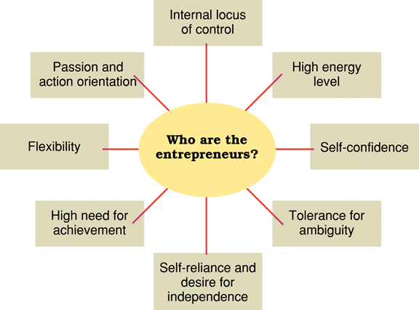
Personal traits and characteristics of entrepreneurs.

Slide 14
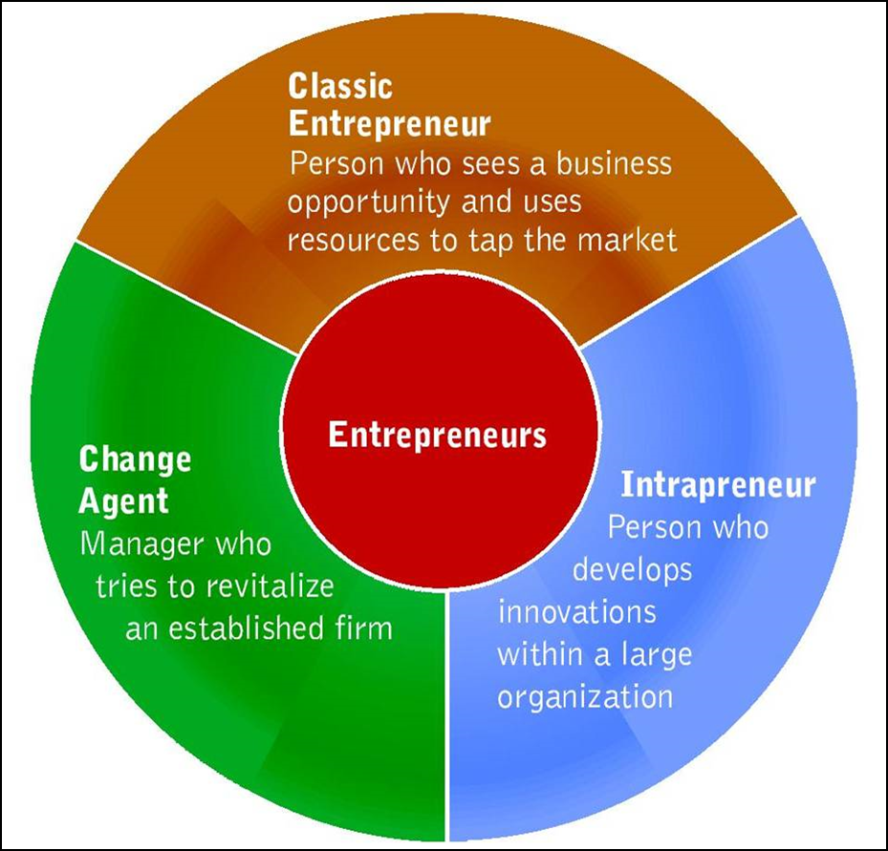
Categories of Entrepreneurs

Slide 15
Categories of Entrepreneurs
Classic entrepreneurs—person who identifies a business opportunity and allocates available resources to tap that market.
Classic entrepreneurs – identify business opportunities and allocate available resources to tap those markets by:
1. Looking for markets that have potential
2. Seeking an advantage through speed
3. Relying on drive and selling ability to assemble money and people quickly

Slide 16
Categories of Entrepreneurs
Change Agent—manager who tries to revitalize an established firm to keep it competitive.
Manager who tries to revitalize an established firm to keep it competitive.

Slide 17
Categories of Entrepreneurs
Intrapreneurship
Entrepreneurially oriented people who seek to develop new products, ideas and commercial ventures within large organizations.
Promoting innovation within organizational structures
An idea to promote creativity
Companies promote in a variety of ways
Skunkworks
Pacing Programs

Slide 18
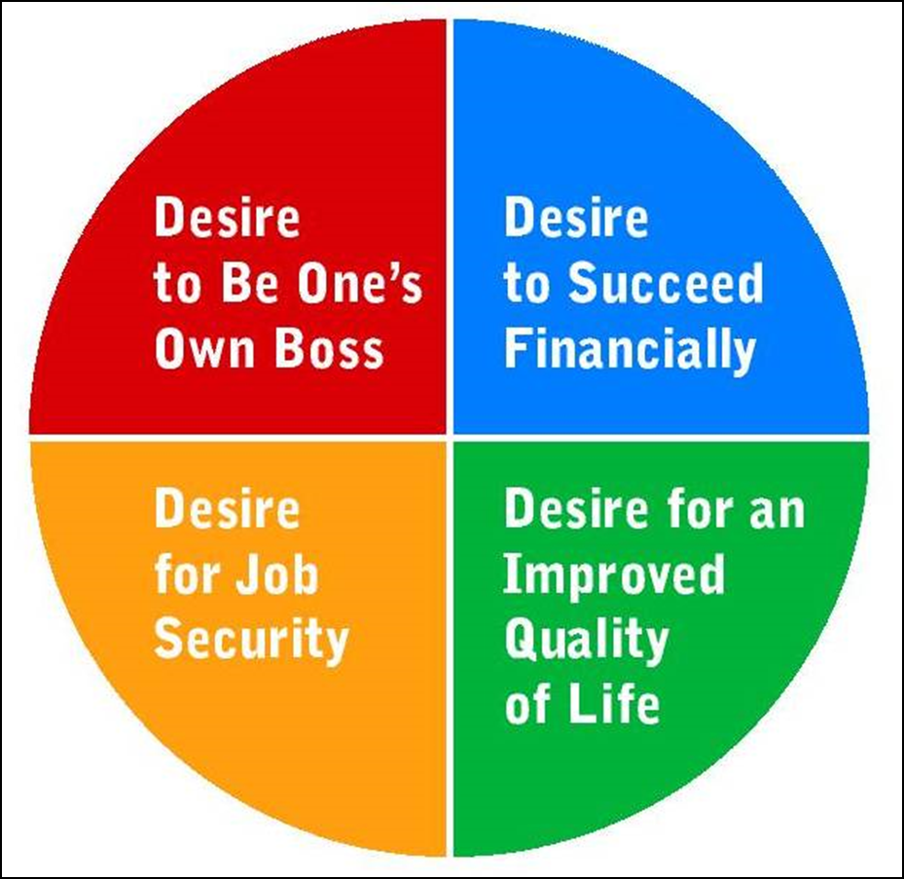
Why People Become Entrepreneurs

Slide 19
Reasons to Choose Entrepreneurship as a Career Path
People become entrepreneurs for different reasons, including:
1. Desire to be own boss
2. Desire to succeed financially
3. However, the path to riches is uncertain and typically very long
4. Desire to improve upon and attain job security
5. However, job security is not guaranteed to the entrepreneur; but greater control is.

Slide 20
Reasons to Choose Entrepreneurship as a Career Path
6. Job security is dependent on customers and investors
7. The entrepreneur’s commitment to employees and customers assists in securing job longevity
8. Dissatisfaction with current employment situation
9. Insufficient rewards and recognition
10. Believe that their ideas represent opportunities to fulfill customer needs
11. Desire for better quality of life

Slide 21
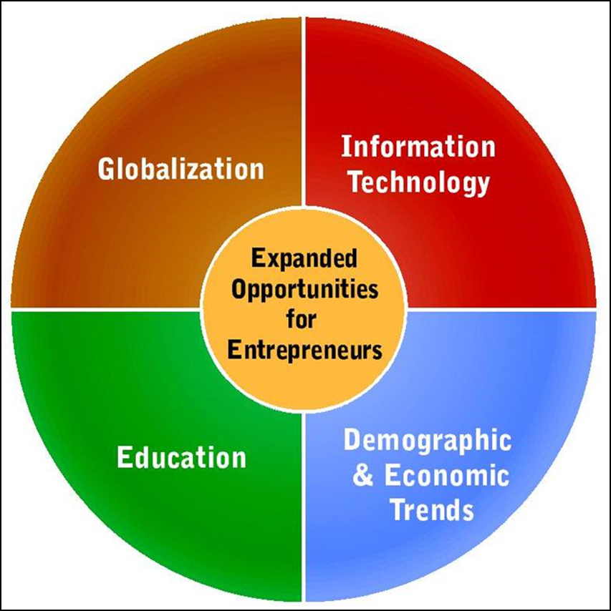
Factors Supporting and Expanding Opportunities for Entrepreneurs

Slide 22
Globalization
Creates many opportunities for entrepreneurs
Allows products to be sold overseas
Provides international talent pool
Now a days
1. Entrepreneurs are marketing their products abroad and hiring international talent.
2. 40% of all small U.S. companies have international sales.
3. Entrepreneurs are also forming business partnerships with foreign partners with similar business goals.

Slide 23
Education
Education – during the past two decades there has been tremendous growth in educational opportunities, including:
1. Hundreds of U.S. colleges offering classes colleges offering entire degrees in entrepreneurship
2. Colleges helping students to start their own businesses
3. Students interacting with CEOs
4. Organizations teaching entrepreneurship to young people
5. National not-for-profit organizations working with college students, faculty advisors, grade school children

Slide 24
Information Technology
Provided a big boost for entrepreneurs
Helps entrepreneurs work quickly and efficiently, provide attentive customer service, increase sales, and project a professional image
Has created demand for new products
Internet is also a challenge for entrepreneurs
Customers can go online, quickly get needed information, and buy from anywhere in the world
Prices of technology have decreased dramatically making those tools more available to entrepreneurs for their businesses.
Lowering prices also mean more consumers have access to the Internet, making e-sales easier.

Slide 25
Demographic and Economic Trends
Demographic trends create opportunities for new goods and services
These trend include:
The aging U.S. population
The emergence of Hispanic Americans as the nation’s largest ethnic group
Growth of two-income families, who have more expendable income and who are seeking ways to make their lives more manageable
Competition for talented workers provides opportunities for assisting companies in locating workers
The need to train workers

Slide 26
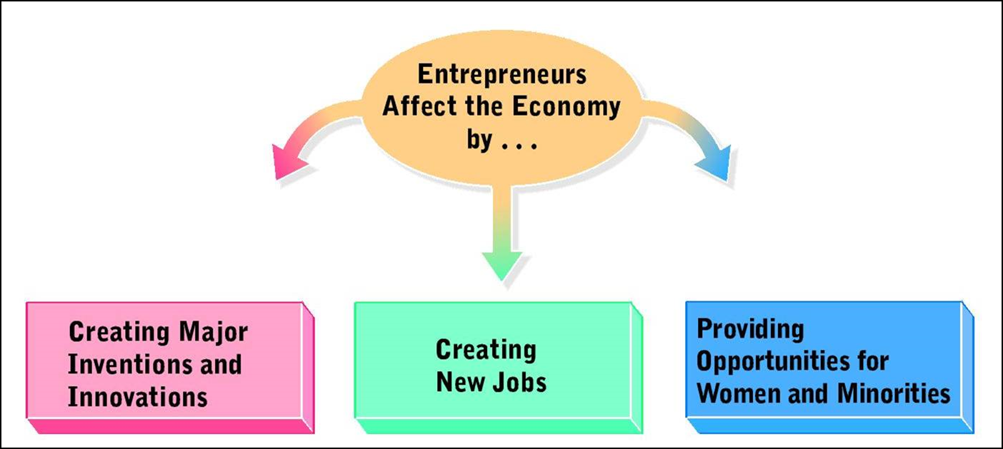
Influence of Entrepreneurs on the Economy

Slide 27
Innovations
Entrepreneurs:
Create new products
Build new industries
Bring new life to old industries
The force behind 66% of the inventions and 95% of the major innovations made since WWII.
Some innovations are born of the entrepreneur’s personal experiences.
Some entrepreneurs identify better ways to service business customers

Slide 28
Job Generation
1. Entrepreneurial startups are the principal job creators in the U.S.
2. The fastest growing start-ups are called gazelles.
3. Entrepreneurial job creation typically involves fewer employees, but is spread over many companies.
4. Entrepreneurs often see missed potential in employees.

Slide 29
Diversity
Entrepreneurship offers excellent economic opportunities for women and minorities
Entrepreneurial businesses help to defeat typical stereotypes.
Many large companies have developed diversity programs to help women and people of color get started as entrepreneurs.

Slide 30
Entrepreneurship around the World
Entrepreneurship Around the World
1. Growth worldwide is phenomenal – although the rates vary greatly
2. Entrepreneurial startup in non-U.S. countries is more difficult, because:
a. government regulation
b. high taxes
c. political attitudes that favor big business
d. cultural values
3. Young people who are more comfortable with the Internet, an important entrepreneurial tool, may overcome current barriers abroad

Slide 31
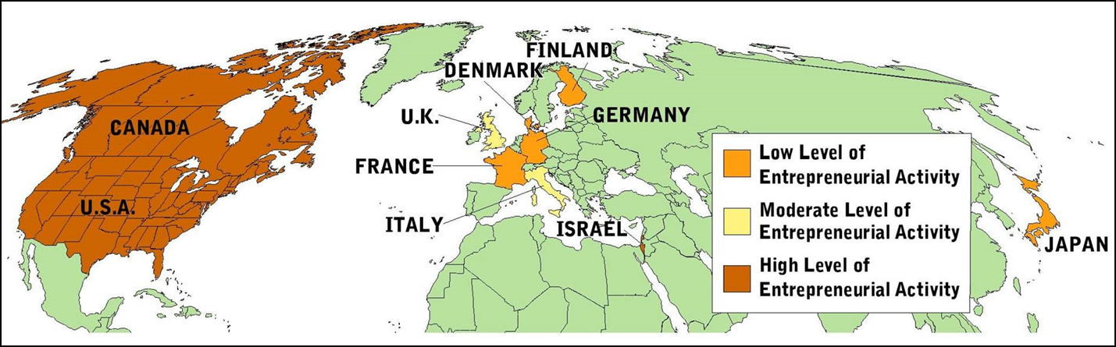
Levels of Entrepreneurial Activity in 10 Countries

